Slide 1

By
CULTURAl CO-ORDINATOR
K.LAKSHMI

Slide 2

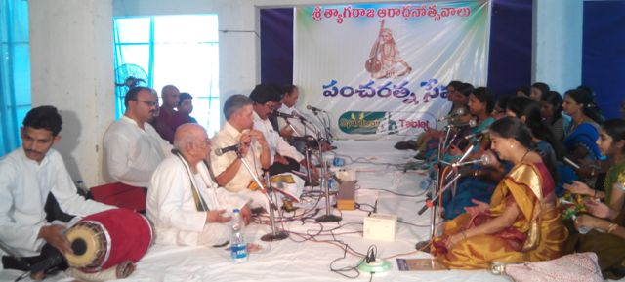
PACHA RATNA SEVA PROGRAM
WEB SITE STATIC CONTENT LAUNCHING
AATMANANDHA LAHARI PROGRAMS

Slide 3

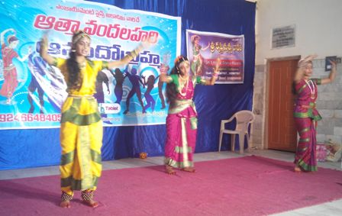
After 2012 a drastic change in end users
Result oriented Masses
Easy to screen Masses to identify who are In need
The best way to inspire and inculcate a blissful and healthy living through spiritual means

Slide 4

DISTRICT LEVEL
ZONAL LEVEL
INTERNATIONAL LEVEL

Slide 5

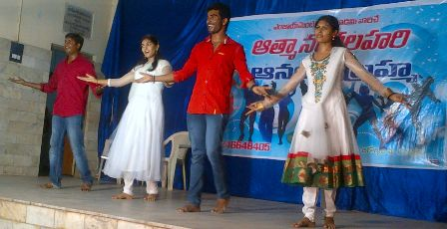
Trough view material window at respective positions based on the program level and place

Slide 6

WHO ARE INTERESTED IN ESA
WHO GOT BELOW 50% MARKS IN 3 DAYS WORK SHOPS
APPOINTING ARTISTS ON SALARY BASIS.

Slide 7

GOLI KO GOLI MARO
12 TABLETS
7 CHAKRAS Etc

Slide 8

FINANCIAL MANAGEMENT
CONDUCTING PROGRAMS
Program publicity

Slide 9
